Slide 1

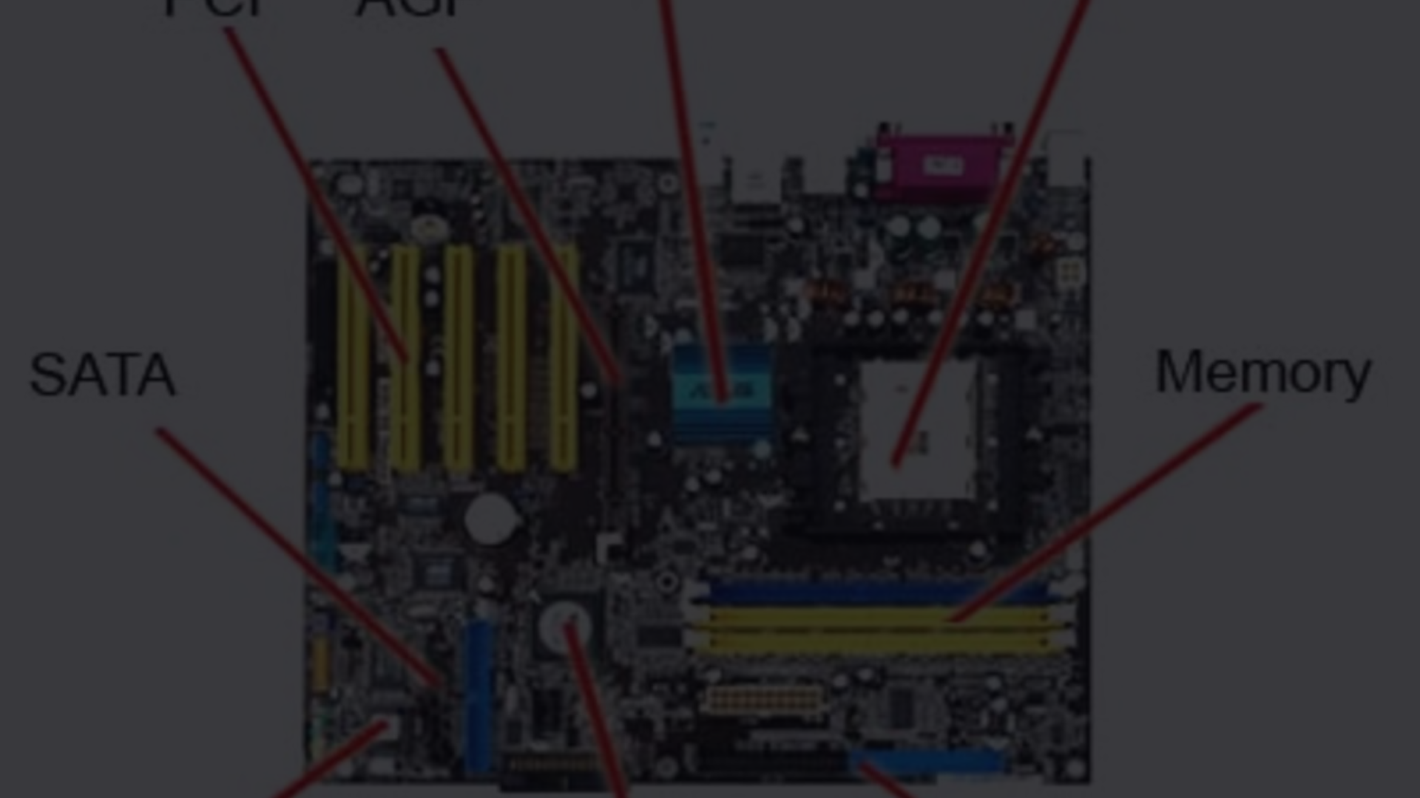
Computer Science Fundamentals
This document explores the fundamental concepts of computers and their role in modern society. We'll delve into the intricate workings of hardware components, software systems, data storage, input/output devices, and networking. By understanding these essential elements, you can gain a deeper appreciation for how computers function and their impact on our daily lives.
kk

Slide 2
Hardware Components
The physical components of a computer system are collectively known as hardware. These components work together to perform essential tasks, enabling the computer to process information and interact with the outside world.
At the heart of every computer lies the central processing unit (CPU), often called the "brain" of the computer. The CPU is responsible for executing instructions and performing calculations. It operates in conjunction with the system memory (RAM), which acts as temporary storage for data that the CPU is actively working with. This data is constantly being accessed and modified as the computer performs its tasks.
Data is stored permanently on storage devices such as hard drives (HDD) and solid-state drives (SSD). These devices provide a persistent repository for operating systems, applications, and user files. To connect all these components, a motherboard serves as a central hub, providing pathways for data to flow between different parts of the computer.

Slide 3
Software and Operating Systems
Software refers to the set of instructions that tell a computer what to do. It's the intangible part of a computer system that makes the hardware come to life. Software can be categorized into two main types: system software and application software.
System software, like an operating system (OS), manages the computer's fundamental operations, providing a platform for other software to run. The OS acts as an intermediary between the user and the hardware, making it easier to use the computer. Popular operating systems include Microsoft Windows, Apple macOS, and Linux.
Application software, on the other hand, consists of programs designed for specific tasks, such as word processing, web browsing, or gaming. These applications rely on the underlying operating system to function and provide users with a wide range of functionalities.

Slide 4
Data Storage and Memory
Data storage is crucial for computers, allowing them to preserve information and access it later. There are two main types of storage: primary storage (memory) and secondary storage.
Primary storage, also known as memory or RAM, is a temporary storage location for data that the CPU is actively using. It's fast and efficient but volatile, meaning data is lost when the computer is turned off. Secondary storage, on the other hand, provides permanent storage for data and includes devices like hard disk drives (HDDs) and solid-state drives (SSDs). These devices offer greater storage capacity and are non-volatile, retaining data even when the computer is powered down.
The difference between RAM and secondary storage can be likened to a desk and a filing cabinet. The desk represents RAM, where you keep the documents you are actively working on. When you're done, you can put these documents away in a filing cabinet, representing secondary storage.
The type and amount of storage you need depend on the computer's intended use. For example, a computer used for gaming might require a large amount of RAM and a high-capacity hard drive, while a laptop for basic tasks like browsing and email might need less storage.

Slide 5
Input/Output Devices
Input/output (I/O) devices are the bridges that connect computers to the outside world. Input devices allow users to enter data into the computer, while output devices display or deliver information back to the user. Some common input devices include keyboards, mice, touchscreens, and scanners. Output devices include monitors, printers, and speakers.
Input
Output
Keyboard
Monitor
Mouse
Printer
Touchscreen
Speakers
Scanner
Projector
Each device plays a vital role in facilitating interaction between the user and the computer. For instance, a keyboard allows you to type text, a mouse enables you to control the cursor on the screen, and a monitor displays visual output.

Slide 6
Computer Networks and the Internet
Computer networks allow computers to communicate and share resources. A network can be as simple as two computers connected via a cable or as vast as the global network known as the Internet.
The Internet is a vast interconnected network of computers, servers, and other devices worldwide. It enables people to access information, communicate, and engage in a wide range of activities. Networks rely on protocols, which are rules that govern how data is transmitted and received between devices.
Common types of computer networks include local area networks (LANs), which connect devices within a limited geographic area, such as an office or home, and wide area networks (WANs), which connect devices over larger distances, such as across cities or countries. Wireless networks, such as Wi-Fi, have become increasingly popular, providing connectivity without the need for physical cables.

Slide 7
Computer Programming and Coding
Computer programming is the process of creating instructions for computers to follow. Programmers use programming languages, such as Python, Java, and C++, to write code that tells a computer how to perform a specific task. These instructions are then translated into machine code, which the computer's CPU can understand and execute.
Programming is essential for developing software applications, websites, games, and other computer programs. It allows programmers to create innovative solutions to problems and automate tasks. The field of computer programming is constantly evolving, with new languages and technologies emerging regularly.
Learning to program can be a rewarding experience, opening up a world of possibilities in the tech industry. Whether you're interested in developing software, creating websites, or simply understanding how computers work, learning a programming language can be a valuable asset.

Slide 8

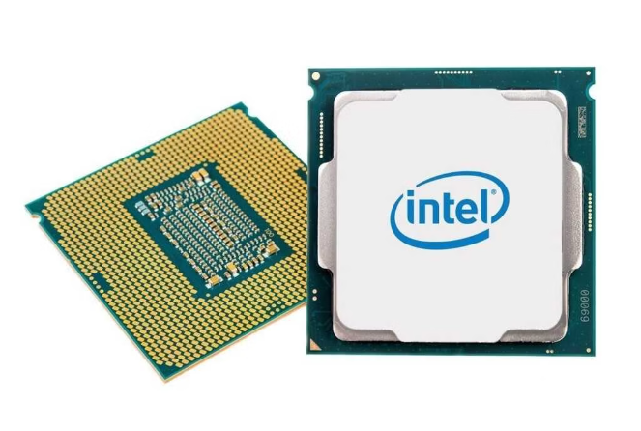
Emerging Technologies in Computing
The field of computing is constantly evolving, with new technologies emerging that push the boundaries of what's possible. Some of the most exciting developments include artificial intelligence (AI), machine learning (ML), cloud computing, and quantum computing.
1
Artificial Intelligence
AI aims to create intelligent machines that can learn, reason, and solve problems like humans. Applications of AI include self-driving cars, personalized recommendations, and medical diagnosis.
2
Machine Learning
ML is a subset of AI that enables computers to learn from data without explicit programming. ML algorithms are used in applications such as fraud detection, spam filtering, and image recognition.
3
Cloud Computing
Cloud computing allows users to access computing resources, such as storage, servers, and software, over the internet. This eliminates the need for physical infrastructure and provides scalable and flexible computing solutions.
4
Quantum Computing
Quantum computing harnesses the principles of quantum mechanics to perform calculations that are impossible for classical computers. This technology has the potential to revolutionize fields such as medicine, materials science, and cryptography.
These technologies are transforming the way we live, work, and interact with the world. As these technologies continue to develop, they promise to create even more innovative and transformative applications in the future.

